Slide 1
Notes on Bayesian deep learning
Apostolos Psaros
Aug 28 2020
Notes:
I will present an overview of the Bayesian framework in deep learning.

Slide 2
Summary
Bayesian model average
Motivation
Parameter priors and GP limit
Approximate inference
Model selection
Uncertainty quality

Slide 3
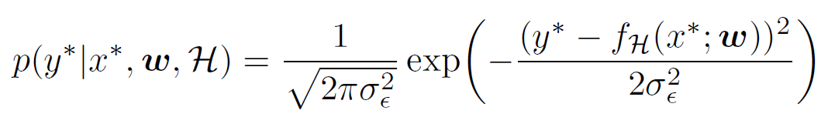
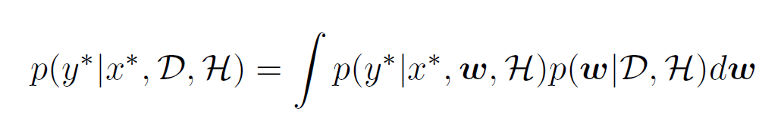


Bayesian model average
Gaussian noise model
Integrate over all plausible parameter settings
No-noise prediction
Single value prediction
Notes:
Suppose we have a dataset D and a model H for making predictions.
The dataset D is a set of paired data for regression and the model H can be a NN with parameters w.
We would like to use the knowledge acquired from the dataset along with the model H for predicting the y value at some test location x.
Note that in this presentation I will be dealing with one dimensional regression problems for simplicity.
But everything I talk about is straightforward to generalize for multidimensional x and y spaces.
How do we make predictions?
Well we can assume that the y value is given by the output of the NN contaminated by some added noise.
But this prediction is for a specific setting of parameters w.
Since the data is always limited, we cannot be sure that a specific setting of parameters is the one that generated the data.
This is where the posterior density comes into play: given the data, many different parameters are possible and each one has a different probability.
According to probability theory we can integrate out all possible parameters w.
This is also known as marginalization of the nuisance variables, that is the variables we do not care about.
In this case it's the parameters we do not care about.
We just want to make predictions without caring about the internal settings of the model.
This is the basis of the Bayesian framework and this integral is known as a Bayesian model average.
Note that the prediction is a PDF rather than a single value.
There is uncertainty in the output because of the noise and because we are not sure which parameter setting is the correct one.
This is known as epistemic uncertainty.
Suppose now that we don't want to consider any noise in our prediction.
That we care about the mean value only.
Then we replace the noise model by a delta function that predicts the NN output and the result is still a PDF.
We have eliminated the noise uncertainty but we still have the epistemic uncertainty.
Finally, suppose that we would like to have a single value as our prediction.
Then we can take the mean of the above PDF and note that we still have an integral over all the possible parameter settings!
Note that in the above equations we haven't made any approximations.
Except of course from the fact that we use an arbitrary model H and an arbitrary Gaussian noise model.
The rest is simple rules of probability.

Slide 4
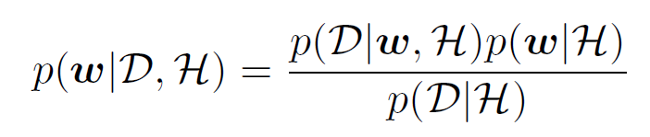
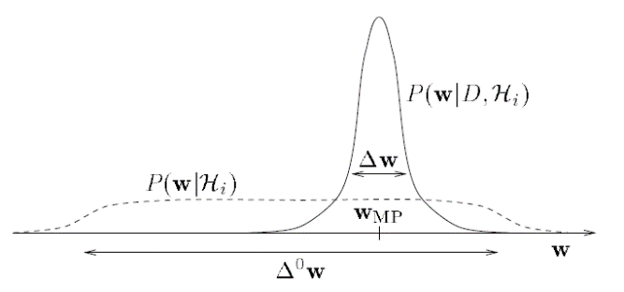
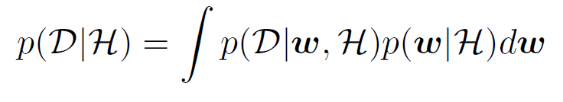
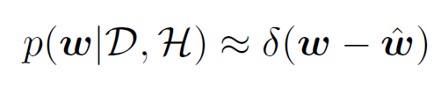


Bayesian model average
Posterior
Evidence
MAP estimate
Bets everything on a single hypothesis – not Bayesian
Notes:
Next, let's see how the posterior is given.
Using Bayes rule the posterior is expressed as the ratio of the likelihood times the prior over the evidence.
The likelihood is the probability that our model produces the data given a particular parameter setting and the prior shows how probable is a parameter setting before seeing any data.
And the evidence is the probability of the data under the model regardless of the selected parameters.
This may be a little overwhelming so let me give you an intuitive explanation.
First, we give a prior probability to each setting of parameters.
This means that before we see any data we specify which parameters are more probable.
As shown in the figure we can start with a very wide and flat prior that doesn't discriminate much between the parameters.
Then as the data arrives, the posterior becomes more and more peaked around certain parameters.
We have more certainty as more data arrives.
As I said before until now we haven't talked about any approximations.
This is the pure Bayesian framework up to this point.
So let's make our first approximation.
Suppose that we approximate the posterior by one mode only found by maximizing the numerator of the ratio.
So it's like the posterior in the figure but with infinitely small width.
Then this results to making a prediction equal to the output of the NN with the selected parameter setting.
Of course, this is the standard training of NNs and I wanted to show you how it can be obtained as a special case of the Bayesian framework.
This is known as the MAP estimate, standing for maximum a posteriori.
The questions is: is it Bayesian?
The answer is no because what makes a technique Bayesian is whether we marginalize over many possible parameter settings.
The MAP estimate bets everything on a single hypothesis and thus it's not Bayesian.
Let me also make a remark here.
It doesn't make sense in my opinion to distinguish between NNs and Bayesian NNs.
This is because standard NNs are usually trained with a regularizer which can be seen as the prior of the parameters.
Also, we optimize for the training loss plus the regularizer which can be seen as posterior maximization.
Therefore, standard training of NNs also involves priors and posteriors.
Instead, what we need to distinguish is standard training of NNs with Bayesian model average.

Slide 5
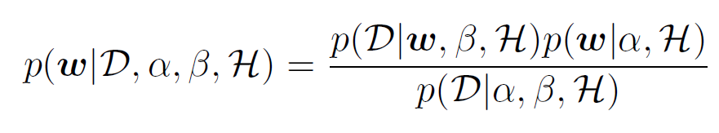
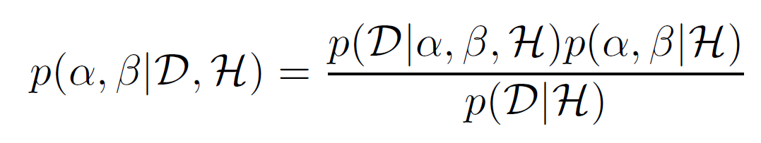

Bayesian model average
Hyperparameters and hyperpriors
Bayes: Integrate over all plausible hyperparameters
Different models: Integrate over all plausible models
Computationally intractable
Notes:
Let's now talk about hyperparameters and hyperpriors.
The noise model we considered before had a certain variance.
We denote it by beta here and of course it is unknown.
The prior we considered also has some unknown parameter, called hyperparameter.
This may be the width of the prior density; the wider the prior the more complex the model is because it can represent more datasets.
So the posterior is written with respect hyperparameters.
And the hyperparameters have their own posterior too: some values are more probable than other after we see the data.
And they have their own prior, called hyperprior.
In this regard, according to the Bayesian framework we should integrate over hyperparameters as well, because they are also nuisance parameters.
If we also consider different models, H1, H2 etc then they have their own posterior.
And we can integrate over them as well.
This is known as hierarchical modeling and is an important pillar of the Bayesian framework.
Of course, performing all these integrations is computationally intractable and we'll need to talk about approximations.

Slide 6
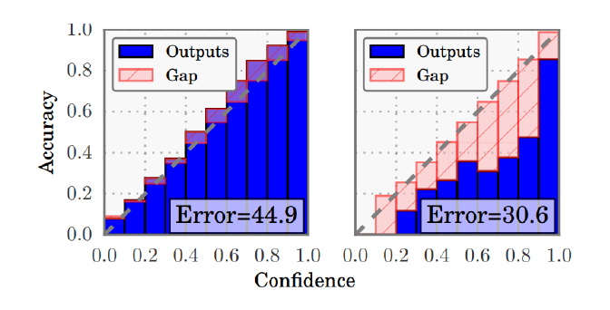
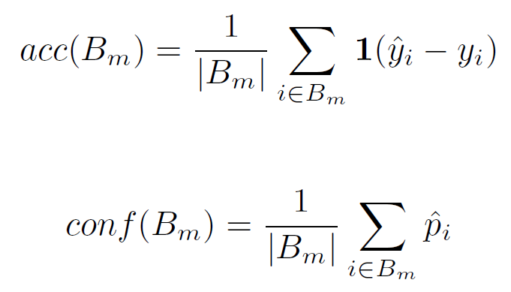
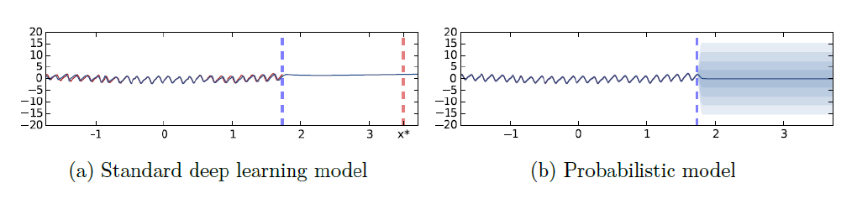
Motivation
Classification calibration
Other recalibration techniques
Recalibration via epistemic uncertainty
Regression calibration
No output uncertainty
Recalibration via epistemic uncertainty
Accuracy
Peaked posterior?
Constant output?
No!
Notes:
So after introducing the Bayesian framework I want to talk about the motivation for using it.
Now that we know what we are talking about.
First, in the classification setting, the output of a NN is a vector of probabilities that sum to one.
Then the the selected class is the one with the largest probability.
As a result, the output of the classifier is sometimes seen as the confidence of the classifier on the selected class.
As a matter of fact, this used to be true in early shallow NNs but not in modern deep NNs.
As you can see in the graph, on the left in early NNs confidence matched accuracy while in deep NNs there is a gap.
The NNs are overconfident, as you can see 0.8 confidence doesn't correspond to 0.8 accuracy.
This is called miscalibration and there are techniques that recalibrate the classifier by modifying the output confidence.
But we are not talk about them.
An alternative is to recalibrate the classifier by incorporating epistemic uncertainty, this means to integrate over possible parameters and not just bet everything on a single one.
Next, consider a standard regression NN.
It outputs a single value without any uncertainty around it.
This is also miscalibrated because it is overconfident.
In other words, it has 100 percent certainty but it's not 100 percent accurate.
See for example the left side of this figure.
The data is to the left of the blue line, but when we ask the NN to make a prediction at a location where it has seen no data it outputs a single value.
In this regard, it can be recalibrated by incorporating epistemic uncertainty as shown on the right side of the figure where the model admits that it has no idea what the prediction should be.
And this is very important when we wanna make safe predictions.
We want the model to know that it doesn't know the answer.
Next is accuracy.
As I said before the standard training of the NN is equivalent to a delta approximation of the posterior around a mode.
Is it a good approximation?
Only if the the posterior is peaked around that mode.
But we all know that in deep NNs this is not the case: there exist a lot of well performing modes in the loss landscape.
Therefore, these are the things that I want you to remember.
In the pure Bayesian framework there are no controversial assumptions or approximations.
We have limited data and we are unsure about what parameters to select.
The standard training of the NN arises as a crude approximation of the Bayesian model average and as we said leads not only to miscalibrated results but also to compromised accuracy.

Slide 7
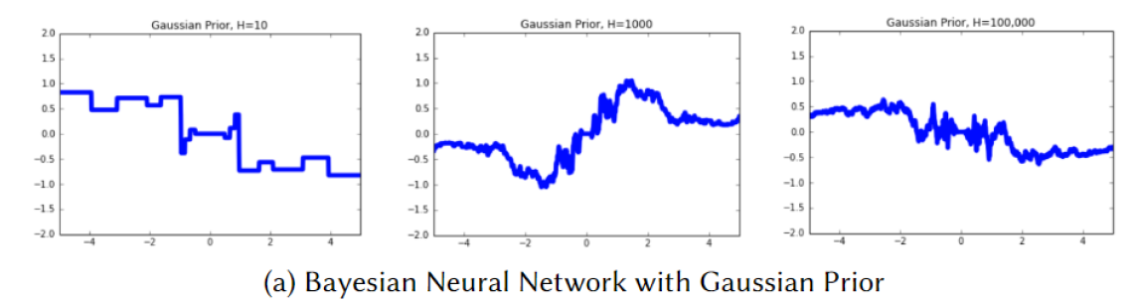
Parameter priors and GP limit
Infinite-width single-layer NN with Gaussian parameter prior
Swapping NNs with GPs or the opposite
Use BNNs instead of GPs: smaller computational cost
Use GPs instead of BNNs: exact Bayesian inference
What if we want to utilize the full capabilities of BNNs?
Notes:
Next, I would like to briefly talk about parameter priors.
It has been shown in the early 90s by Radford Neal that single-layer NNs with Gaussian parameter priors become equivalent to Gaussian processes in the infinite width limit.
This is based on the central limit theorem.
Here is a figure for you to see the difference in random samples for different numbers of hidden units.
On the left, for 10 hidden units in the layer we see that there are jumps.
As Radford Neal mentions in his thesis this means that it matters which hidden units are active and which are not.
And the function can change drastically depending on that.
On the contrary, on the right side where the number of hidden units tends to infinity, the individual contributions of the hidden units are negligible.
Now, this can be an advantage for us.
For example, one can use a Bayesian NN instead of a GP because the computational cost is smaller for handling large datasets.
Or one can use a GP that has similar properties to a Bayesian NN because GPs are more convenient for performing exact Bayesian inference.
However, if we don't want to give away the ability of NNs to learn useful representations of the data then we need to somehow avoid this GP behavior.

Slide 8
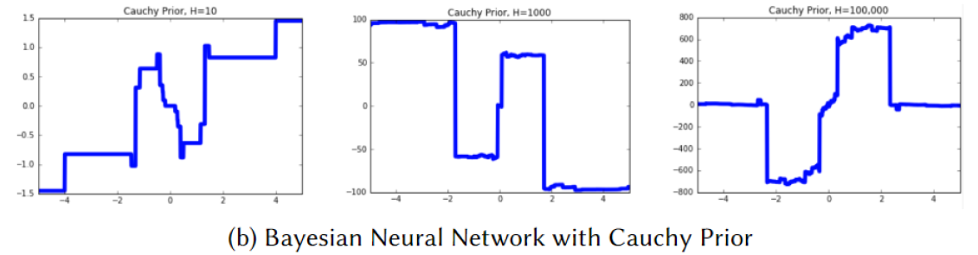
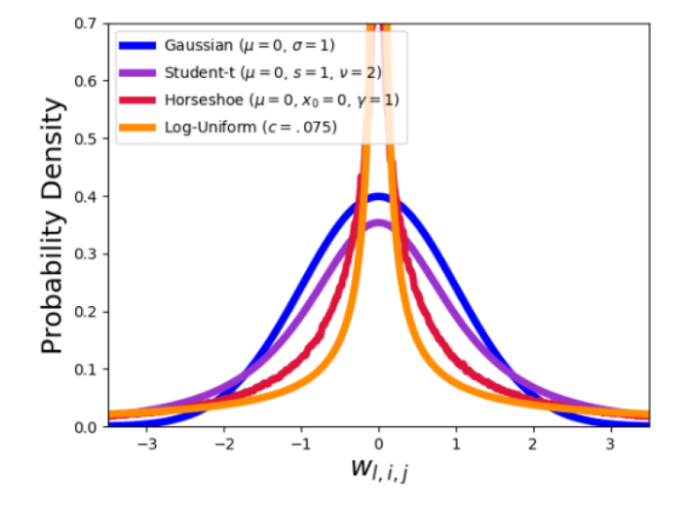
Parameter priors and GP limit
CLT-breaking parameter priors: Heavy tails
Gaussian prior with variance drawn from hyperprior
Student-t
Cauchy
Laplace
Horseshoe
Automatic model selection
Notes:
In order to do so we need to consider CLT-breaking priors, that is priors with heavy tails.
As you can see in the figure even for large widths if we use a Cauchy prior the regression line still has jumps and doesn't behave like a GP.
Examples of such priors are the Student-t, the Cauchy, Laplace and horsehoe priors which can all be constructed by having a Gaussian prior with variance drawn from an appropriate hyperprior.
Overall, the type of prior we use has a significant effect on the behavior of the samples.
Also, it is desirable to use peaked priors so that units are incentivized to be zero.
For example, we can group the outgoing parameters of a hidden unit together and select a common prior with a common variance.
If after training the common variance is found to be very small then we can conclude that this unit is useless to the model and can be deleted.
We can therefore use priors to perform model selection.

Slide 9
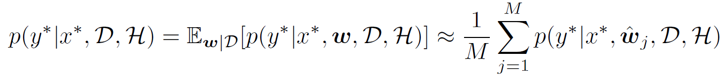
Approximate inference - Introduction
Recall Bayesian model average
or
Monte Carlo estimation
But how to obtain samples from the posterior?
Notes:
Next, I would like to talk about how to approximately obtain the posterior.
First, recall that the Bayesian model average integrates over the parameters and if we have hyperparameters then we integrate over them as well.
An approximation to this integral is given by Monte Carlo estimation, that is we obtain samples from the posterior and we evaluate the NN on those parameter samples.
For example, suppose there are no hyperparameters.
We obtain w samples from the posterior and approximate the integral by a sum.
The question therefore becomes how to obtain samples from the posterior.

Slide 10

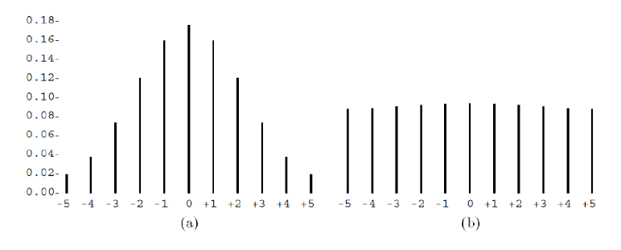
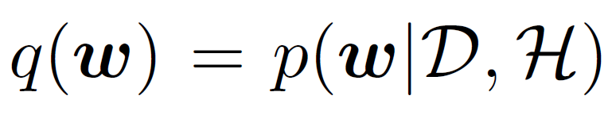
Approximate inference - MCMC
Ergodic Markov chains
Unique invariant distribution
Sampling from invariant distribution
Example: Confined random walk
Gibbs sampling
Sequence of transitions:
Sample w1 from p(w1|w2, w3)
Sample w2 from p(w2|w1, w3)
Sample w3 from p(w3|w1, w2)
Conditional distribution not available in NNs: useful for hyperparameter tuning
Hamiltonian Monte Carlo
Stay put with p=1/2
Move +1 with p=1/4
Move -1 with p=1/4
Notes:
One family of approaches is Markov chain Monte Carlo methods.
In short, we construct an ergodic Markov chain that whose stationary distribution is the posterior we are interested in.
By doing so we can obtain samples from the posterior just by simulating a single realization of the Markov chain.
MCMC methods deserve a separate presentation so I decided to not talk much about them.
However, I do want to give you a simple example that I'm sure you'll keep in mind whenever you hear the word MCMC.
Suppose we want to sample from the uniform distribution.
One possibly unorthodox way to do so is by constructing a confined random walk with the following rules:
With probability one half we stay at the same location, with one quarter we move +1 and with another quarter we move -1.
And all this confined to -5 to +5.
This Markov chain has as stationary distribution the uniform distribution from -5 to 5.
This means that if we simulate a realization of the Markov chain and take a sample after a large number of steps it is equivalent to taking a sample from the uniform distribution.
The simplest example of MCMC is Gibbs sampling in which at each step we sample from the conditional distribution of one parameter given the current values of all the others.
However in NNs these conditional distributions are not available so Gibbs sampling can only be used for hyperparameter tuning as I will show you later.
What is used in the context of NNs is Hamiltonian Monte Carlo, but this is a whole different story and as I said requires a separate presentation.

Slide 11
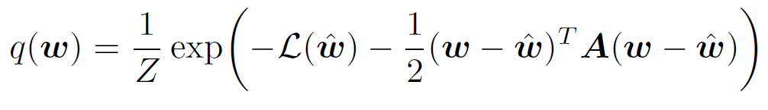

Approximate inference – Laplace Approximation
Laplace approximation
Fit a Gaussian to a discovered mode
Approximate posterior by
Covariance matrix via Hessian
Easy to draw samples from
Multimodal approximation: fit a separate Gaussian to each discovered mode
Notes:
Another technique is Laplace approximation, according to which we follow the standard training of NNs but we fit a Gaussian distribution around the discovered mode.
This is equivalent to a quadratic Taylor approximation of the loss around the discovered optimal solution.
For doing so we need the Hessian which plays the role of the covariance matrix of the fitted Gaussian.
Note also that it is easy to draw samples from the Gaussian distribution and if we obtain multiple optima then we can fit a different Gaussian for each one.
Finally, all these are done for fixed hyperparameters, which I will show you later how to tune.

Slide 12
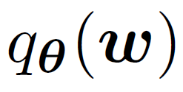
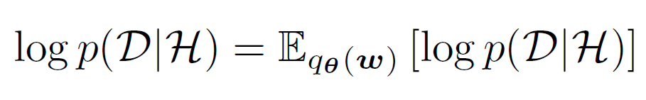
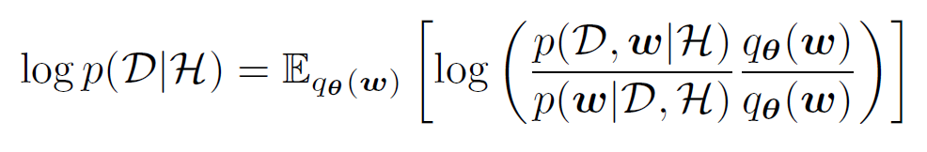
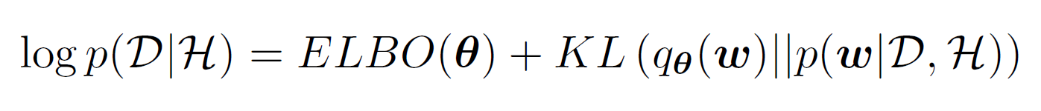
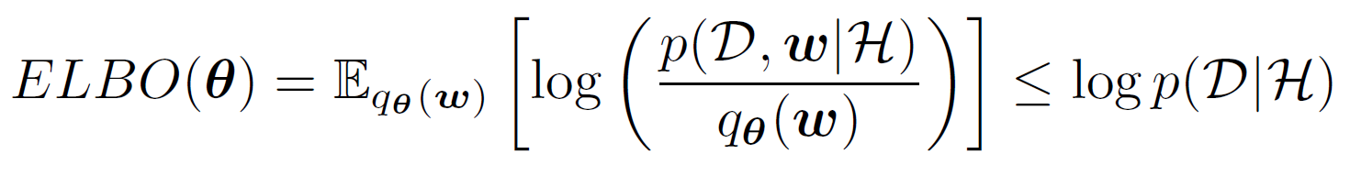
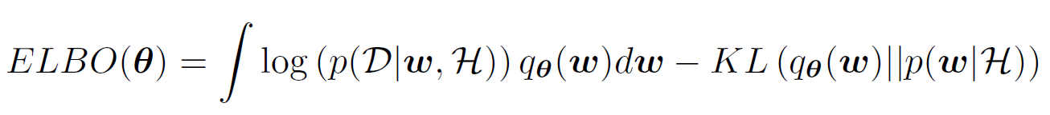
Approximate inference – Variational inference
Approximate posterior by
Rewrite evidence as
Maximize ELBO: Explain data well, while being close to the prior
Approximation depends on family
Notes:
Next is possibly the most widely used inference technique, variational inference in which we approximate the posterior by a so-called variational family parametrized by theta.
Therefore we solve for theta and then we obtain samples from q theta instead of the true posterior.
Let's see how it works.
First we start with log evidence and we write it equivalently as the mean with respect to the approximate posterior.
It's a constant after all.
Then with some straightforward manipulation we write the log evidence as the some of some function of theta and the KL divergence of the true and the approximate posterior.
This function is called ELBO because the KL divergence is always positive and the ELBO is a lower bound of the evidence.
Of course we don't have access to this KL divergence.
But we do have access to the ELBO.
If we maximize the ELBO we automatically minimize the posterior approximation error.
The ELBO is given as the sum of a term that measures how well the model explains the data, the integral term is the likelihood of the data, and minus the KL divergence of the prior from the approximate posterior.
In other words by maximizing the ELBO we have a trade off between explaining the data well and being close to the prior.
How good the approximation is depends on the variational family, and this is an important topic because if affects the quality of the epistemic uncertainty we obtain.

Slide 13
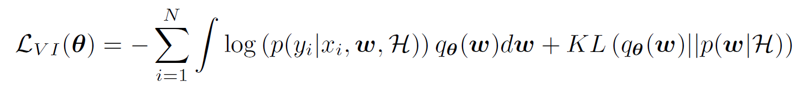
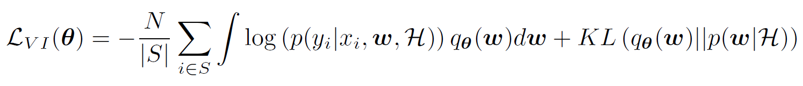
Approximate inference – Variational inference
Computational efficiency and tractability
Costly computations over entire dataset: use data sub-sampling
Intractable integral: use estimators
Bayes by backprop
Dropout as VI
Notes:
Next, let's take a look at minimization objective L, which is the negative ELBO, for N datapoints.
There are two problems here.
One is that for large datasets we need to go over the whole dataset in each update.
We can use data sub-sampling as we do with standard NNs.
The other is that the integral is intractable.
For this, we use estimators.

Slide 14
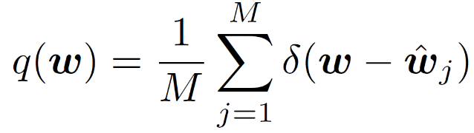
Approximate inference – Deep ensembles
Approximate posterior by
M modes obtained by M SGD runs with random initialization
Ensemble of models: M forward passes at test time
Notes:
Another technique is deep ensembles.
It is usually considered non-Bayesian but can also be seen as Bayesian in the following way:
Consider an approximation of the posterior as a sum of delta functions.
The centers of these delta functions are different optima obtained by standard training of NNs.
Then for making a prediction we can take the average of these M models and thus approximate the Bayesian model average.
Note that this requires M forward passes for each test point, one for each optimal parameter setting.

Slide 15
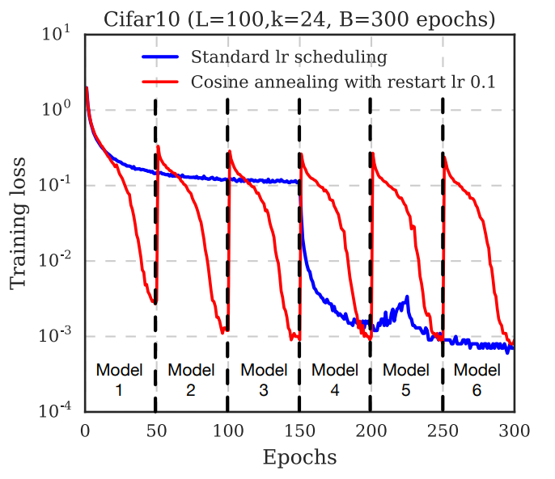
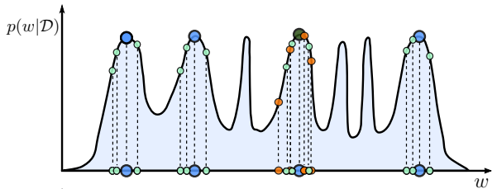
Approximate inference – SGD-based approaches
Requires a single SGD trajectory – no additional cost compared to standard training
Cyclical learning rate
Ensemble of models
Weight averages: SWA, SWAG
Multi-SWAG
There is more to be gained by exploring new basins, than continuing to explore the same basin.
Notes:
Finally, there is a family of techniques that use a single SGD trajectory for approximating the Bayesian model average.
Specifically, instead of using the standard learning schedule (see the blue line for an example), they use a cyclical learning rate:
the learning rate is reduced up to a certain point, a sample is collected, and then the learning rate jumps back to a large value (so that a very different weight is visited next) before it drops again.
By doing so we have two options.
Either we create an ensemble of models as before and at test time we perform M forward passes, or we average the weights and we have just one model.
An alternative is to not only take the average of the weights but also their variance and therefore fit a Gaussian distribution on the samples.
Note that this is very different from Laplace approximation we talked about before.
Here we fit a Gaussian on the samples obtained from a training trajectory; we don't use the Hessian as in Laplace approximation.
This is called SWAG.
Finally an alternative is to combine deep ensembles and SWAG.
This is called Multi-SWAG.
We do the training M times and each time we fit a Gaussian to the samples collected from the training trajectory.
In the figure, with blue you can see the samples collected from deep ensembles.
With green the samples from multi-SWAG and with orange the samples from variational inference.
What we need to remember is that especially in NNs that have so many modes we can better approximate the Bayesian model average by exploring different modes rather than by exploring in full a single mode and its neighborhood.

Slide 16
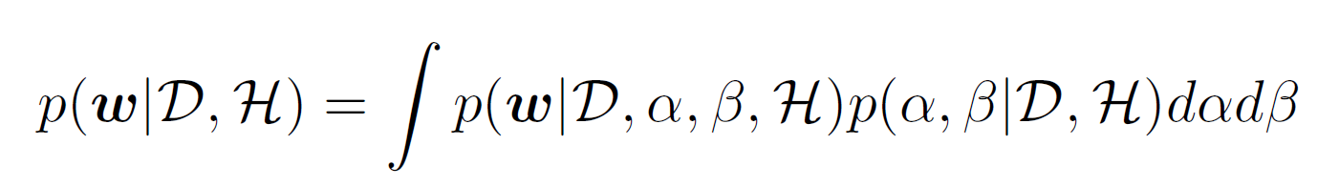
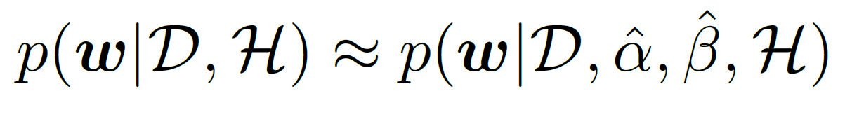
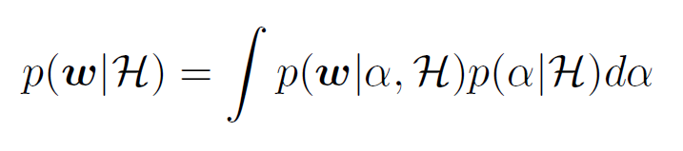
Model comparison – Hyperparameters
Optimize
Evidence framework
Cross-validation
Sample
Global Gibbs sampling
Sample weights given hyperparameters (e.g., HMC)
Sample hyperparameters given weights (e.g., Gamma distribution)
Integrate out upfront: obtain true prior
Notes:
Next topic is model comparison, which essentially means comparing between different hyperparameters and between different architectures.
Let's see what we can do with hyperparameters.
The first thing we can do is to optimize them according to some criterion.
For example we can optimize them with cross-validation as we do in standard training with regularization parameters or by using the evidence framework which I will present in the next slide.
In any case, this is equivalent to replacing the integral over all possible hyperparameters by the mode of the integrand.
And when it comes to prediction we draw samples from this approximate posterior.
As you can see the posterior we sample from has fixed hyperparameters.
Another approach is to sample from the global posterior that includes both the parameters and the hyperparameters.
Recall that a couple slides ago I told you that Gibbs sampling is not useful for drawing samples from the parameter posterior because we don't have the conditional distribution of one parameter given the others.
But we can use Gibbs sampling for drawing all the parameters together given the hyperparameters and then drawing hyperparameters having the parameters fixed.
This is equivalent to drawing samples from their joint posterior.
Note that in the sum here we have beta j because the hyperparameter is different for every sample whereas above we just have the optimal one.
Finally another approach is to integrate out the hyperparameters before we even see any data.
We obtain the so called true prior this way and don't have to deal with hyperparameters again.

Slide 17
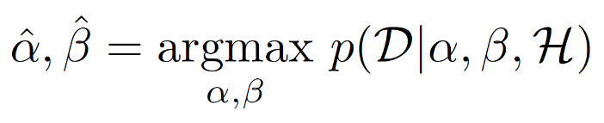

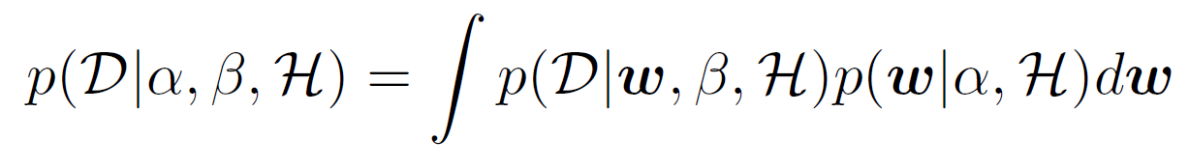
Model comparison – Evidence framework
Also known as empirical Bayes
Optimize
Automatically penalizes over-complex models
Algorithm alternates between
Parameter optimization
Hyperparameter optimization
Laplace approximation: Analytical expression for evidence
Variational inference: ELBO includes prior
Notes:
Next, let me give you some information regarding the evidence framework.
First, you may already know it as empirical Bayes.
In essence, the hyperparameters are obtained by optimizing the evidence which is the probability of the dataset after averaging over the parameters.
As I said before it is used because it is an approximation of the integral over the hyperparameters.
And because we can't optimize the hyperparameter posterior, we instead optimize the evidence, which is the likelihood of the dataset.
Usual practice.
But apart from its use as an approximation the evidence has a nice property.
It penalizes overcomplex models automatically.
Therefore a purely Bayesian approach not only introduces naturally regularization, but also gives a way for selecting the regularization constants.
Now in terms of how it works in practice, we can have the algorithm alternate between optimizing for the parameters and optimizing for the hyperparameters.
In Laplace approximation recall that the posterior for fixed hyperparameters is Gaussian.
By using this fact we can obtain an analytical expression for the hyperparameter optimization step.
Also in variational inference, instead of evidence recall that we have the ELBO.
So we have a step of optimizing the ELBO with respect to the hyperparameters.

Slide 18
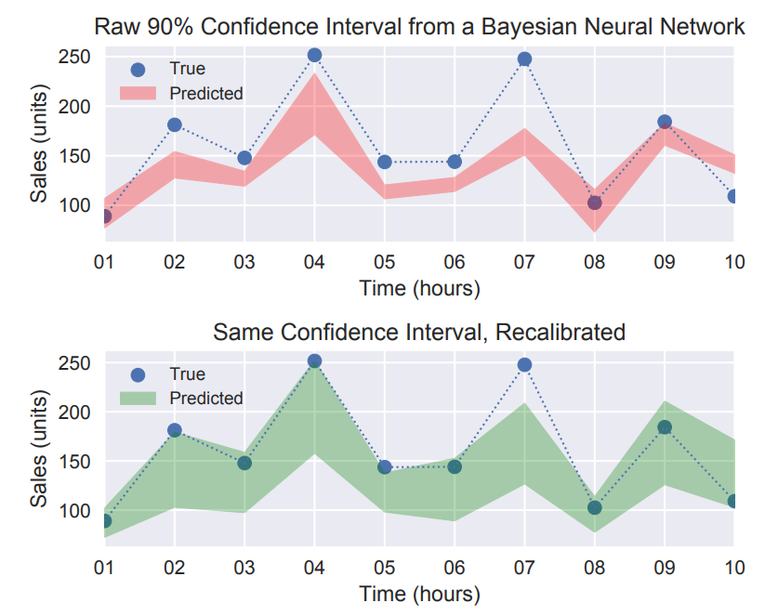
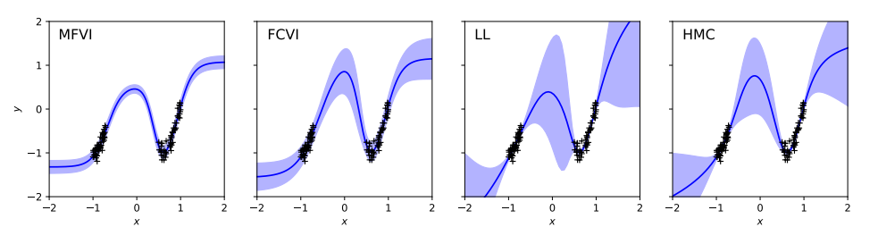
Uncertainty quality
In-domain uncertainty
In-between uncertainty: important for active learning!
Bayesian uncertainty estimates often fail to capture the true data distribution
The model is often overconfident in areas that should be highly uncertain
Notes:
Lastly, note that the uncertainties we obtain with Bayesian techniques are not necessarily accurate.
For example, suppose we want to estimate the y value at some new x location that is in the same domain as the training data.
Then the Bayesian model outputs (in the best case) the distribution of the y values at that location.
But the distribution we obtain is not necessarily calibrated which means that if we get a probability of 90 percent for y to be less than 1 for instance, it doesn't mean that indeed y is less than 1 90 percent of the time.
So Bayesian techniques by incorporating epistemic uncertainty help us calibrate our results but this doesn't mean that the results are perfectly calibrated.
For this reason in the past 2-3 years there have been efforts to recalibrate these uncertainty estimates.
Now suppose we want to obtain the uncertainty at some location far from the training data.
In this case we would like the model to output larger uncertainty at those locations.
This is for example useful for active learning because high uncertainty will drive our new measurement locations.
In this regard it has been shown recently that typical variational inference techniques do not satisfy this requirement.
Recall that dropout is equivalent to a form of variational inference and shares its weaknesses.
As you can see in the very left side of the figure, if we use a Gaussian variational family for the weights with zero correlations the results are overconfident in areas with no data.
This changes a little if we use full covariance Gaussian families as you can see in the next one.
The situation is even better if we use a Laplace approximation.
And of course all these are always compared with hamiltonian monte carlo which is computationally costly but is considered to be the ground truth for Bayesian inference.

